Slide 1
Hadoop
Session I - Hadoop Overview

Slide 2
Bigdata CoE and Service Line team
1.1, July 30, 2012

Slide 3









Icons Used
Hands on Exercise
Questions
Tools
Coding Standards
Test Your Understanding
Case Study
Best Practices & Industry Standards
Demonstration
Workshop

Slide 4
Overview - Hadoop
This chapter will cover the concepts of Big Data, Distributed Computing, and Hadoop in detail.

Slide 5
Objectives
After completing this chapter you will be able to:
Describe what is Big Data, Data Sources, Distributed Computing,
Describe what is Hadoop
Describe Hadoop components
Describe Hadoop characteristics

Slide 6
Data
Data
Lowest level of abstraction to derive information and knowledge
Big Data
Volume, Velocity, Variety (Multi structured), Complexity
“The ‘digital universe’ – will grow to 2.7 zettabytes in 2012, … data volume will reach 35 zettabytes by 2020.” — IDC

Slide 7

Data Sources
Data
Web logs
Social Media
Machine Sensors
Website data feeds
PPT presentations
Audios
Videos

Slide 8
Analysis
To generate meaningful values - Data Mining or Data Science or Data Research or Data Analytics
Innovating new business models, products and services
Productivity growth and consumer surplus
Replacing human decision making with automated algorithms - increase the accuracy
“Our research suggests that big data and analytics could improve productivity by 0.5 to 1 percent annually, as well as billions of dollars in new value” — McKinsey Quarterly

Slide 9
Distributed Computing
Set of Commodity hardware connected to a network forms distributed computing infrastructure
As a combined entity, can produce similar computing resource as multiprocessor super computer, but at a very low cost.
Move algorithm or computation near to the data rather moving data for computation

Slide 10
Distributed Computing - Architecture
Client-server: Smart client code contacts the server for data then formats and displays it to the user. Input at the client is committed back to the server when it represents a permanent change.
3-tier architecture: Three tier systems move the client intelligence to a middle tier so that stateless clients can be used. This simplifies application deployment. Most web applications are 3-Tier.
n-tier architecture: n-tier refers typically to web applications which further forward their requests to other enterprise services. This type of application is the one most responsible for the success of application servers.
highly coupled (clustered): refers typically to a cluster of machines that closely work together, running a shared process in parallel. The task is subdivided in parts that are made individually by each one and then put back together to make the final result.
Peer-to-peer: an architecture where there is no special machine or machines that provide a service or manage the network resources. Instead all responsibilities are uniformly divided among all machines, known as peers. Peers can serve both as clients and servers.
Space based: refers to an infrastructure that creates the illusion (virtualization) of one single address-space. Data are transparently replicated according to application needs. Decoupling in time, space and reference is achieved.

Slide 11

What is Hadoop
Hadoop is a high-performance distributed data storage and processing system. Its two major subsystems are :
HDFS for storage
Mapreduce for parallel data processing.
It can store any kind of data from any source, inexpensively and at very large scale, and it can do very sophisticated analysis of that data easily and quickly.
Hadoop automatically detects and recovers from hardware, software and system failures.
Hadoop provides scalable, reliable and fault tolerant services for data storage and analysis at very low cost.

Slide 12

Hadoop – Project
Hadoop was created by Doug Cutting, who named it after his son's toy elephant
Apache Hadoop
Developer(s) | Apache Software Foundation
Stable release | 1.0.3 / May 16, 2012; 2 months ago
Preview release | 0.22.0 / December 10, 2011; 7 months ago
Development status | Active
Programming language used | Java
Operating system | Cross-platform
Type | Distributed File System
License | Apache License 2.0
Website | hadoop.apache.org

Slide 13
History
2003.2 First MapReduce library written at Google
2003.10 Google File System paper published
2004.12 Google MapReduce paper published
2005.7 Doug Cutting reports that Nutch now use new MapReduce implementation
2006.2 Hadoop code moves out of Nutch into new Lucene sub-project
2006.11 Google Bigtable paper published
2007.2 First HBase code drop from Mike Cafarella
2007.4 Yahoo! Running Hadoop on 1000-node cluster
2008.1 Hadoop made an Apache Top Level Project

Slide 14
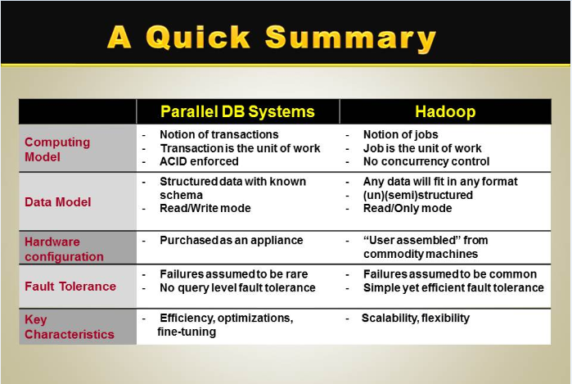
Hadoop Vs. Parallel DB Systems

Slide 15
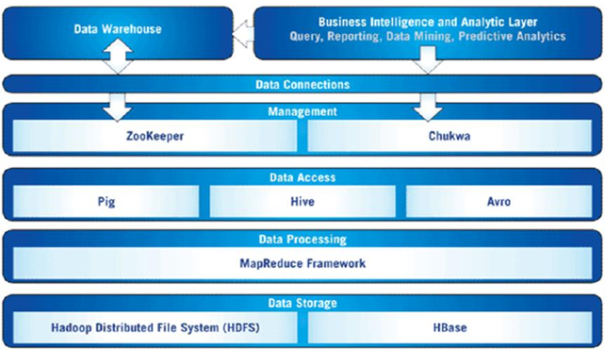
Hadoop Ecosystem, and Analytics

Slide 16
Why Hadoop ?
Store anything. Hadoop stores data in its native format, exactly as it arrives at the cluster. Translating data on arrival so that it fits into a fixed data warehouse schema destroys information. Because Hadoop stores data without forcing that transformation, no information is lost. Downstream analyses run with no loss of fidelity. Of course it is always possible to digest, analyze and transform data, but Hadoop allows the data analyst to choose how and when to do that.
Control costs. Hadoop is open source software that runs on commodity hardware. That combination means that the cost per terabyte, for both storage and processing, is much lower than on older proprietary systems. As storage and analytic requirements evolve, a Hadoop installation can, too. Adding or removing storage capacity is simple. You can dedicate new hardware to a cluster incrementally, as required, and can retire nodes from one easily, too. As new analytic techniques are developed, they are easy to apply to new and existing data with MapReduce.

Slide 17
Why Hadoop ?
Proven at scale. You may not have petabytes of data that you need to analyze today. Nevertheless, you can deploy Hadoop with confidence because companies like Facebook, Yahoo! and others run very large Hadoop instances managing enormous amounts of data. When you adopt a platform for data management and analysis, you are making a commitment that you will have to live with for years. The success of the
biggest Web companies in the world demonstrates that Hadoop can grow as your
business does.

Slide 18
Characteristics
Very large files - files that are hundreds of megabytes, gigabytes, or terabytes or petabytes in size.
Streaming data access - HDFS is built around the idea that the most efficient data processing pattern is a write-once, read-many-times pattern, time to read the whole dataset is more important than the latency in reading the first record
Commodity hardware - Hadoop doesn’t require expensive, highly reliable hardware to run on. It’s designed to run on clusters of commodity hardware (commonly available hardware available from multiple vendors)

Slide 19
Usage Pattern
ETL – Extract, Transform, Load
Put large data source (eg. Log files) onto the Hadoop File System
Perform aggregations, transformations, normalizations on the data
Load into RDBMS / data mart
Reporting and Analytics
Run canned and ad-hoc queries over large data
Run analytics and data mining operations on large data
Produce reports for end-user consumption or loading into data mart
Data Processing Pipelines
Multi-step pipelines for data processing
Coordination, scheduling, data collection and publishing of feeds
SLA carrying, regularly scheduled jobs

Slide 20
Usage Pattern
Machine Learning & Graph Algorithms
Traverse large graphs and data sets.
Implement machine learning algorithms over massive data sets
General Back-End Processing
Implement significant portions of back-end, batch oriented processing on the grid
General computation framework
Simplify back-end architecture

Slide 21























Who uses Hadoop?

Slide 22
What is Hadoop used for?
Searching/ Text mining
Log processing
Recommendation systems
Business Intelligence/Data Warehousing
Video and Image analysis
Archiving
Graph creation and analysis
Pattern recognition
Risk assessment
Sentiment Analysis

Slide 23
Hadoop Components
Hadoop Distributed File System, or HDFS
HDFS is the storage system for a Hadoop cluster. When data arrives at the cluster, the HDFS software breaks it into pieces and distributes those pieces among the different servers participating in the cluster. Each server stores just a small fragment of the complete data set, and each piece of data is replicated on more than one server.
Distributed data processing framework called MapReduce
Because Hadoop stores the entire dataset in small pieces across a collection of servers, analytical jobs can be distributed, in parallel, to each of the servers storing part of the data. Each server evaluates the question against its local fragment simultaneously and reports its results back for collation into a comprehensive answer. MapReduce is the plumbing that distributes the work and collects the results

Slide 24
Test Your Understanding
What is Hadoop ?
What are the components of Hadoop ?
What are the characteristic of Hadoop?
When should we use Hadoop ?
Compare Hadoop and Parallel DB systems
Name the components in Hadoop eco system?

Slide 25
Summary
Hadoop is a high-performance distributed data storage and processing system.
Major components are – HDFS and Mapreduce
Hadoop was created by Doug Cutting
Hadoop became a top level Apache project in 2008
It can store any kind of data from any source, inexpensively and at very large scale, and it can do very sophisticated analysis of that data easily and quickly.
Hadoop automatically detects and recovers from hardware, software and system failures.
Hadoop provides scalable, reliable and fault tolerant services for data storage and analysis at very low cost.

Slide 26
Hadoop
Session II – HDFS Overview

Slide 27
Overview - HDFS
This chapter will cover the concepts of Hadoop distributed file system (HDFS) in detail.

Slide 28
Objectives
After completing this chapter you will be able to :
Describe HDFS components
Describe Hadoop building blocks
HDFS components fail over
Replication process overview

Slide 29
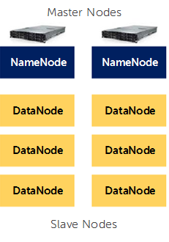
HDFS Components
A HDFS cluster has two types of node operating in a master-worker pattern:
namenode (the master)
number of datanodes (workers)

Slide 30
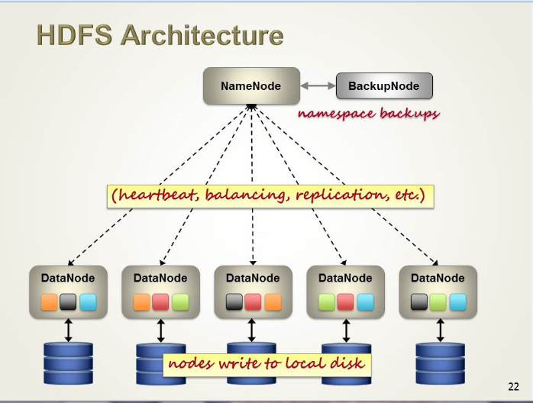
HDFS Architecture

Slide 31
Blocks
Files in HDFS are broken into block-sized chunks, which are stored as independent units.
Default is 64MB
Blocks are replicated to different data nodes depending on the value of replication factor.
Block placement algorithm is rack-aware

Slide 32
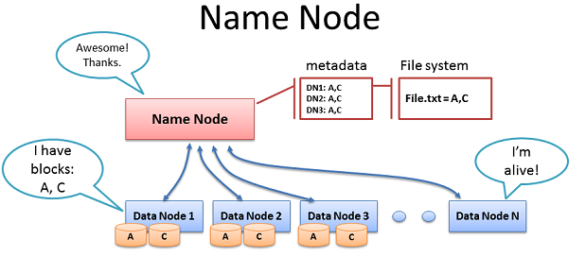
Namenode
Manages File System Namespace
Maps a file name to a set of blocks
Maps a block to the DataNodes where it resides
Cluster Configuration Management
Replication Engine for Blocks
Stores Information in memory
Each entry in the memory requires 150 byte.
This information is stored persistently on the local disk in the form of two files: the namespace image(fsimage) and the edit log.

Slide 33
Namenode Metadata
Meta-data in Memory
The entire metadata is in main memory
No demand paging of meta-data
Types of Metadata
List of files
List of Blocks for each file
List of DataNodes for each block
File attributes, e.g creation time, replication factor

Slide 34
Namenode Metadata contd…
A Transaction Log (called EditLog)
Records file creations, file deletions. Etc
FsImage
The entire namespace, mapping of blocks to files and file system properties are stored in a file called FsImage.
NameNode can be configured to maintain multiple copies of FsImage and EditLog.
Checkpoint
Occur when NameNode startup
Read FsImange and EditLog from disk and apply all transactions from the EditLog to the in-memory representation of the FsImange
Then flushes out the new version into new FsImage

Slide 35
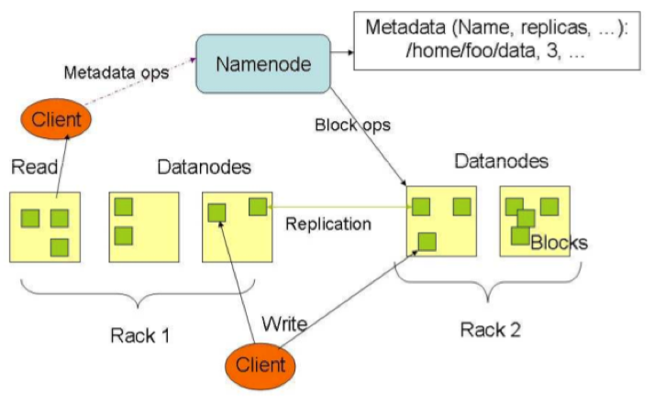
NameNode Failure
A single point of failure
Transaction Log stored in multiple directories
A directory on the local file system
A directory on a remote file system (NFS/CIFS)
Need to develop a real HA (high availability) solution

Slide 36
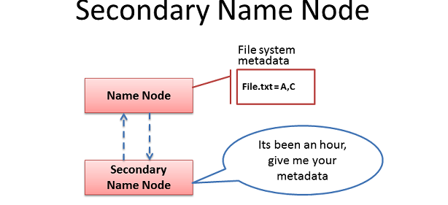
Secondary Namenode
It has to be called as Checkpoint node now
Copies FsImage and EditLog from NameNode to a temporary directory
Merges FSImage and EditLog into a new FSImage in temporary directory.
Uploads new FSImage to the NameNode

Slide 37
Datanode
Datanodes are the work horses of the filesystem
They store and retrieve blocks when they are told to (by clients or the namenode).
Block Report
Periodically sends a report of all existing blocks to the NameNode
Facilitates Pipelining of Data
Forwards data to other specified DataNodes

Slide 38
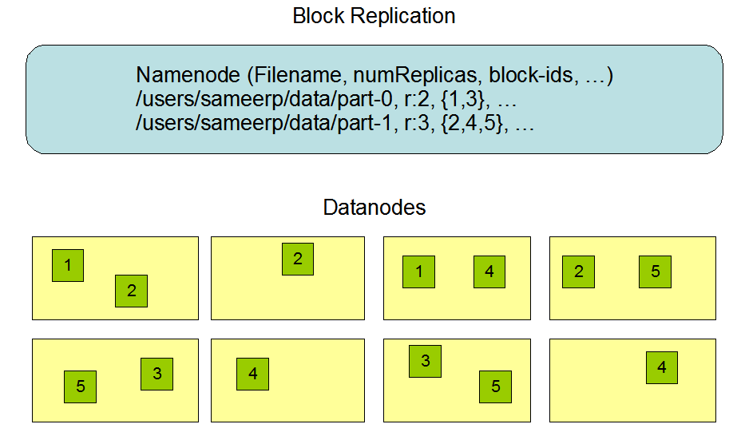
Replication Factor
Default is 3x replication.
The block size and replication factor are configured per file.

Slide 39
Replica Placement
Rack aware policy (Replication factor = 3)
The first replica on the same node as the client (for clients running outside the cluster, a node is chosen at random, although the system tries not to pick nodes that are too full or too busy).
The second replica is placed on a different rack from the first (off-rack), chosen at random.
The third replica is placed on the same rack as the second, but on a different node chosen at random.

Slide 40
Test Your Understanding
What is the role of a Namenode ?
What is the role of a Datanode ?
How is replication works?
What is the role of secondary Namenode / check-point node?

Slide 41
Summary
HDFS is built around the idea that the most efficient data processing pattern is a write-once, read-many-times pattern.
Hadoop is not meant for real time processing.
Namenode is the central repository for metadata.
Datanodes are workhorses of the framework.
Check point node / secondary name node is used to keep the last version of editlog and fsimage and get the incremental changes to create a new version and send it back to namenode

Slide 42
Hadoop
Session III – HDFS Deep Dive

Slide 43
HDFS Deep Dive
This chapter will cover the internal working, cluster setup and failure modes in Hadoop.

Slide 44
Objectives
After completing this chapter you will be able to:
Explain the read and write operations in Hadoop
Setup a single node and multi node Hadoop cluster
Describe various failure modes and recovery steps
Describe where Hadoop can not be used

Slide 45
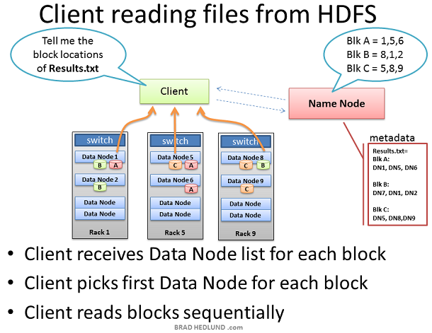
Client reading from HDFS

Slide 46
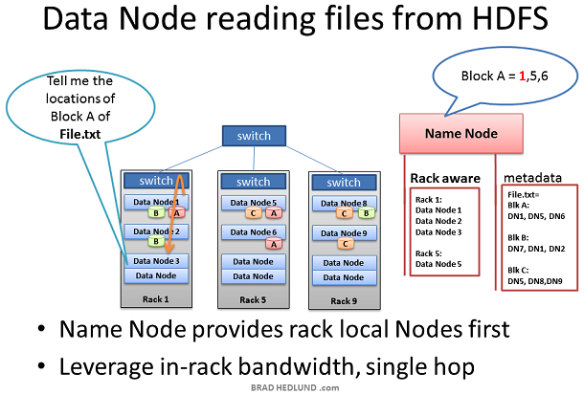
Data node reading from HDFS

Slide 47
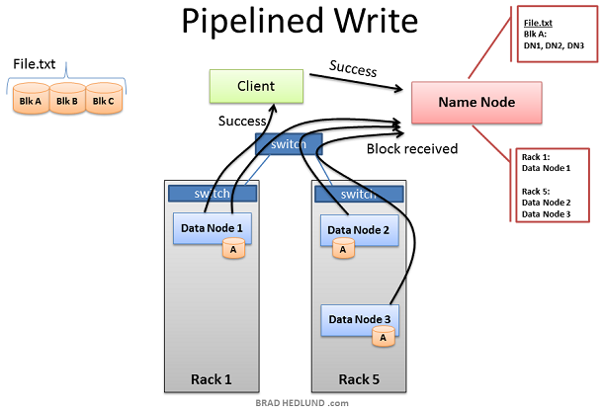
Client writing to Data node

Slide 48
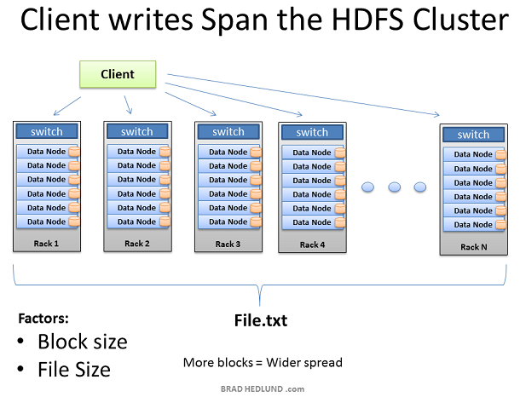
Anatomy of file write

Slide 49
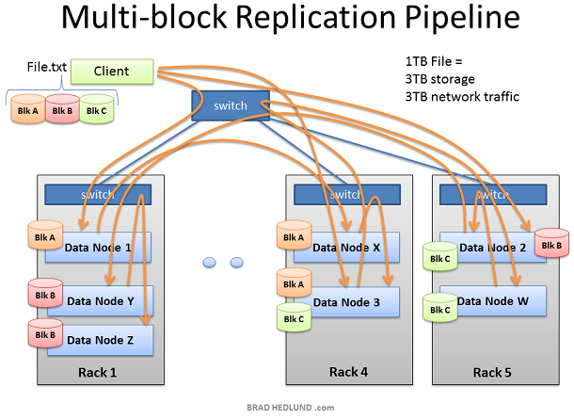
Multi Node Replication

Slide 50
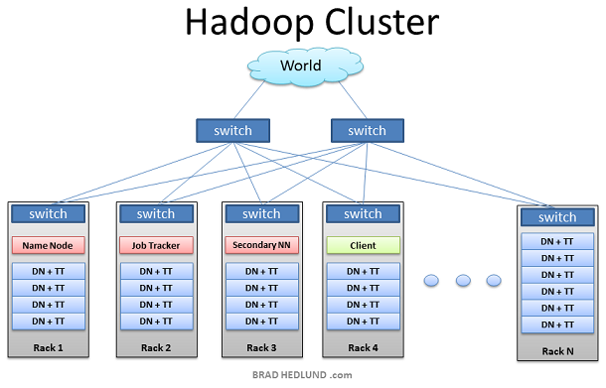
Hadoop Cluster

Slide 51
Hadoop Setup - Modes
Single Mode
Psuedo Distributed Mode (Connectivity using SSH())
Cluster Setup
Namenode + JobTracker or Name Node – JobTracker separatly
Secondary Namenode (Checkpoint node)
Task Tracker + Data Nodes

Slide 52
Configuration Scripts

Slide 53
Cluster Administration Scripts

Slide 54
Cluster Administration Scripts

Slide 55
Hadoop Environment variables

Slide 56
Hadoop Environment variables

Slide 57
Default ports used

Slide 58
Hadoop Core configuration
Hadoop Core configuration: The Hadoop Core is configured by two XML files:
Hadoop-default.xml provides reasonable defaults and comes with the Hadoop distribution. (The configuration provided by this default file is suitable for a single machine instance).
Hadoop-site.xml is where cluster-specific information is specified by the cluster administrator.

Slide 59
Slaves and masters
Slaves and masters: Two files are used by the startup and shutdown commands.
The slaves file contains a list of hosts, one per line, that are to host DataNode and TaskTracker servers.
The masters file contains a list of hosts,one per line, that are to host secondary NameNode servers

Slide 60
Per-process runtime environment
Per-process runtime environment: The file hadoop-env.sh is responsible for tailoring the per-process environment. In particular, it includes the JAVA_HOME variable , which provides the JVM installation location.
This file also offers a way to provide custom parameters for each of the servers. Hadoop-env.sh is sourced by all of the Hadoop Core scripts provided in the conf directory of the installation

Slide 61
Reporting
Hadoop Core may be configured to report detailed information about the activities on the cluster
The file hadoop-metrics.properties controls the reporting. The default is to not report.

Slide 62
Hadoop Core Server Configuration
The hadoop-default.xml file defines more than 150 parameters, divided into six groups:
Global properties
Logging Properties
I/O Properties File System properties
Mapreduce Properties
IPC properties

Slide 63
Critical Properties
fs.defult.name – If it is not configured, there is no shared file system. The URI specified here informs the Hadoop Core framework of the default file system. The default value is file:///, which instructs the framework to use the local file system.
hadoop.tmp.dir – If it is not configured, data loss will occur. It informs the framework of the directory to use for all Hadoop Core server data storage.
mapred.job.tracker - The mapred.job.tracker parameter is critical to configure. If it is not configured, only a single machine will be used for task execution The URI specified in this parameter informs the Hadoop Core framework of the JobTracker’s location. The default value is local, which indicates that no JobTracker server is to be run, and all tasks will be run from a single JVM.

Slide 64
Common errors in setup

Slide 65
Namenode Recovery
1. Shut down the secondary NameNode.
2. Copy the contents of the secondary:fs.checkpoint.dir to the Namenode:dfs.name.dir.
3. Copy the contents of the secondary:fs.checkpoint.edits to the Namenode:dfs.name.edits.dir
4. When the copy completes, start the NameNode and restart the secondary NameNode

Slide 66
DataNode Recovery and Addition
The procedure for adding a new DataNode to a cluster and restarting a failed DataNode are identical.
The server process just needs to be started, assuming the configuration is correct, and the NameNode will integrate the new server or reintegrate a restarted server into the cluster.
The command hadoop-daemon.sh start datanode will start a DataNode server on a machine, if one is not already running

Slide 67
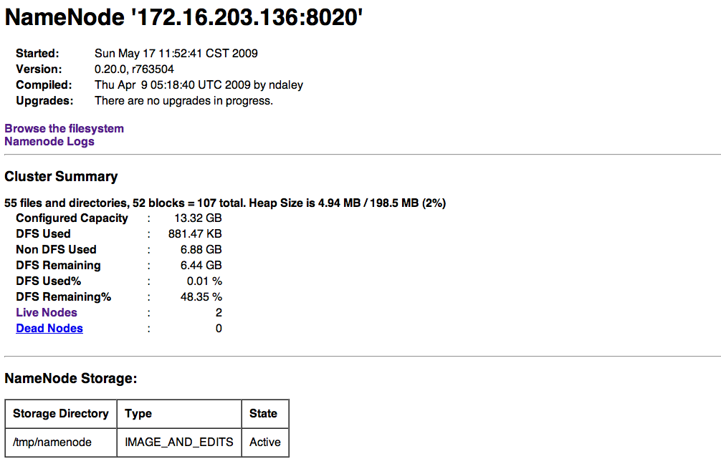
Web Interface
The NameNode web interface will be available via HTTP on port 50070 http://master:50070

Slide 68
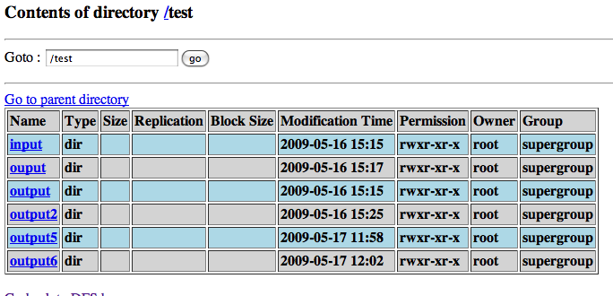
Web Interface

Slide 69
Hadoop is not a good fit for…
Low-latency data access - Applications that require low-latency access to data, in the tens of milliseconds range, will not work well with HDFS.
Lots of small files - Since the namenode holds filesystem metadata in memory, the limit to the number of files in a filesystem is governed by the amount of memory on the namenode.
Multiple writers, arbitrary file modifications - Files in HDFS may be written to by a single writer. Writes are always made at the end of the file. There is no support for multiple writers, or for modifications at arbitrary offsets in the file

Slide 70
Test Your Understanding
Which are the essential properties for a cluster setup?
What does a master file do?
What does a slave file do?
In which areas is Hadoop not a good fit?

Slide 71
Summary
Hadoop cluster can be setup in three modes
Standalone
Pseudo distributed
Fully distributed
Hadoop can not recover from Namenode failure automatically.
Hadoop can recover from Data node failure.
Hadoop is not a good fit for Low-latency data access , Lots of small files, Multiple writers, arbitrary file modifications.

Slide 72
Hadoop
Session IV – HDFS Hands On

Slide 73
HDFS Hands On
Workshop would include:
Walkthrough of all HDFS related process scripts
HDFS commands

Slide 74
Hadoop
Session V – Map Reduce Overview

Slide 75
Overview – Map Reduce
This chapter will introduce you to the concepts of parallel processing using Mapreduce paradigm.

Slide 76
Objectives
After completing this chapter you will be able to :
Describe a Mapreduce job and its components
Advantages of a Mapreduce job
Explain Job submission and execution
Explain Task execution
Explain Failure of Task and Job

Slide 77
What is Mapreduce
MapReduce is a programming model designed for processing large volumes of data in parallel by dividing the work into a set of independent tasks.

Slide 78
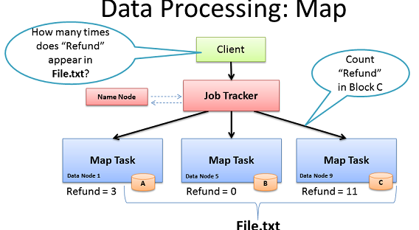
Map Phase
The first phase of a MapReduce program is called mapping. A list of data elements are provided, one at a time, to a function called the Mapper, which transforms each element individually to an output data element.

Slide 79
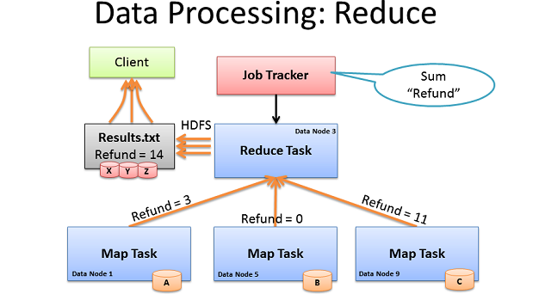
Reduce Phase
Reducing lets you aggregate values together. A reducer function receives an iterator of input values from an input list. It then combines these values together, returning a single output value.

Slide 80
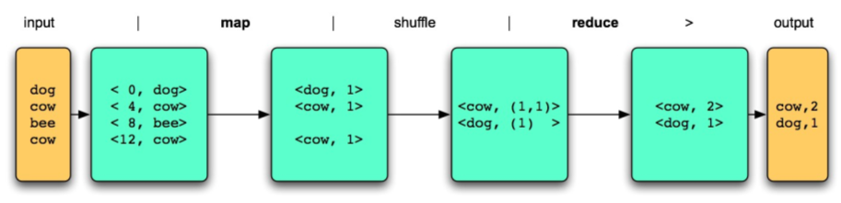
MapReduce Programming Model
User define two functions
map (K1, V1) → list(K2, V2)
takes an input pair and produces a set of intermediate key/value
reduce (K2, list(V2)) → list(K3, V3)
accepts an intermediate key I and a set of values for that key. It merges together these values to form a possibly smaller set of values
shuffle / sorting

Slide 81
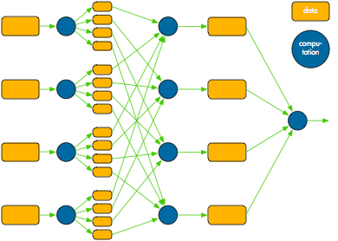
MapReduce Architecture

Slide 82
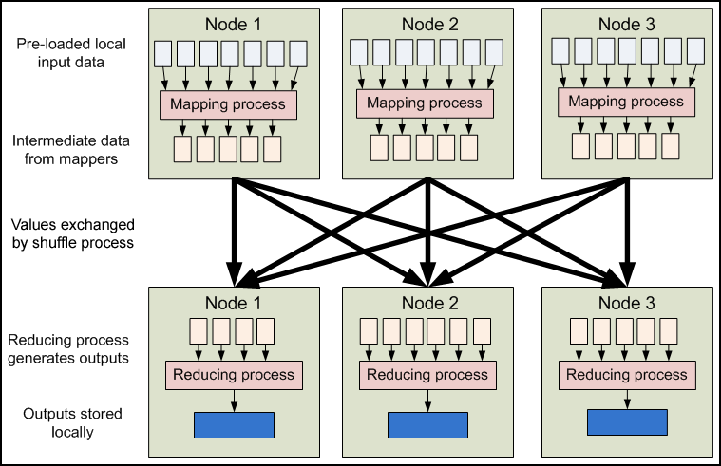
MapReduce Execution Flow

Slide 83
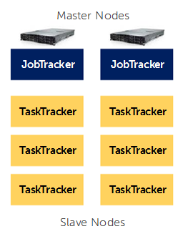
MapReduce Components
At the highest level, there are four independent entities:
The client, which submits the MapReduce job.
The jobtracker, which coordinates the job run. The jobtracker is a Java application whose main class is JobTracker.
The tasktrackers, which run the tasks that the job has been split into. Tasktrackers are Java applications whose main class is TaskTracker.
The distributed filesystem (normally HDFS), which is used for sharing job files between the other entities.

Slide 84
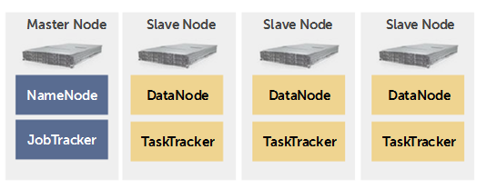
HDFS and MapReduce Infrastructure
NameNode and JobTracker on the same server
DataNode and TaskTracker on the same server

Slide 85
Hadoop
Session VI - NoSQL (HBase), Pig, Teradata Connector to HDFS

Slide 86
Overview – HBase, Pig
This chapter will introduce you to the concepts of HBase – NoSQL Hadoop Database, Pig Programming and Teradata to HDFS connector

Slide 87
HBase
Overview
Functionality
HBase is an open-source, distributed, versioned, column-oriented store modeled after Google’s Big Table
Data is stored as Key-Value Pairs
Features compression and in-memory operation
Can server as input/output to MapReduce jobs in Hadoop
Strictly consistent reads and writes Linear and modular scalability.
Row-level atomic operations including compare-and-swap ops like incrementing counters
Augmented key-value schemas, the user can group columns into families which are configured independently
CLI
Zoo keeper
HMaster
Region Server
Region Server
Region Server
Region
Region
Region
Region
Region
Region
HDFS

Slide 88
Hbase …
Pros / Cons
Pros | Cons
Extremely large map tables - billions of rows X millions of columns Automatic and configurable sharding of tables Automatic failover support | No support for SQL For smaller datasets, may not perform as fast as RDBMS
Use cases
Optimizations for near real time access
Storing data that’s used as a sink or a source to analytical jobs
Useful when database schema is flexible

Slide 89
Pig
Overview
Functionality
Yahoo! developed Pig to analyze large data sets
Pig-Latin, is the data flow language, helps easy development of MapReduce
Internally generates sequence of MapReduce Jobs
Inbuilt support for common functionalities like,
Merging / Filtering / Grouping / Sorting
It can run in 2 modes:
Local Mode : Doesn’t require Hadoop cluster
Clustered Mode : Run on Hadoop cluster
User defined functions
Nested relational data model
Scan centric analytical workloads
Easy to plug in user code
Does not impose a data model
Complex data types
Ready to use common functionalities like Join, Filter, Group, Sort etc.
Pig Script
Logical Plan
Physical Plan
Pig Engine
M/R Plan
Automatic
Rewrite + Optimize
Map-Reduce
Hadoop
HDFS

Slide 90
Pig …
Pros / Cons
Pros | Cons
Complex data flow process Automatic Optimization Opens MapReduce to non-Java programmers | No Ad-Hoc Query support Cannot perform custom Optimization
Use cases
Time sensitive data loads Processing many data sources Analytic Insight Through Sampling | Iterative processing Data pipelining Scan centric analytical workloads

Slide 91
Sqoop
To import data from a relational database management system (RDBMS) such as MySQL or Oracle into the Hadoop Distributed File System (HDFS), transform the data in Hadoop MapReduce, and then export the data back into an RDBMS.
Uses MapReduce to import and export the data, which provides parallel operation as well as fault tolerance.
$ sqoop import --connect jdbc:teradata://hostname/DATABASE=MY_BASE --username sqooptest --password xxxxx --table MY_DATA

Slide 92
Terdata Sqoop Connector
The Cloudera Connector for Teradata is designed to use Teradata's FastExport and FastLoad JDBC capabilities to import and export data to HDFS.
Cloudera Connector for Teradata is a standard Sqoop extension that allows Sqoop to interoperate with Teradata Data Appliance via Teradata JDBC Version 13.10.00.10 drivers.
The connector provides an all-or-nothing atomicity for complete import and export operations. This feature helps avoid inconsistencies that can arise from task failures or retries.

Slide 93
Terdata Connector - Limitations
No import into HBase.
Does not support AVRO format.
Does not support free-form queries.
Does not support import-all-tables.
Does not support imports from views.
Does not support data types INTERVAL, PERIOD, and DATE/TIME/TIMESTAMP WITH TIME ZONE

Slide 94
Hadoop
Session VII – Map Reduce Deep Dive

Slide 95
Map Reduce Deep Dive
This chapter will give you to the deep dive usage of parallel processing using Mapreduce paradigm.

Slide 96
Objectives
After completing this chapter you will be able to :
Explain Job submission and execution
Explain Task execution
Explain Failure of Task and Job

Slide 97
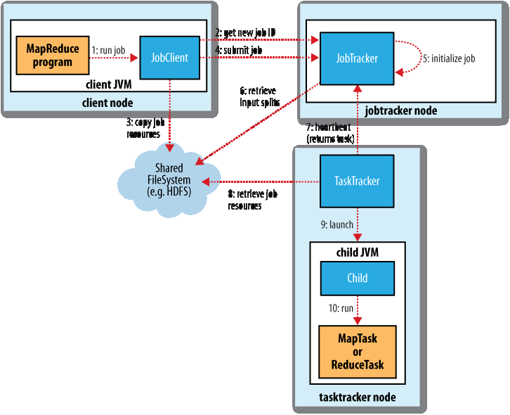
MapReduce Anatomy

Slide 98
Job submission process
JobClient’s submitJob() asks the jobtracker for a new job ID (by calling getNewJobId() on JobTracker)
Checks the output specification of the job. For example, if the output directory has not been specified or it already exists, the job is not submitted and an error is thrown
Computes the input splits for the job. If the splits cannot be computed, because the input paths don’t exist, for example, then the job is not submitted and an error is thrown
Copies the resources needed to run the job, including the job JAR file, the configuration file and the computed input splits, to the jobtracker’s filesystem in a directory named after the job ID. The job JAR is copied with a high replication factor (controlled by the mapred.submit.replication property, which defaults to 10) so that there are lots of copies across the cluster for the tasktrackers to access when they run tasks for the job.

Slide 99
Job Initialization
When the JobTracker receives a call to its submitJob() method, it puts it into an internal queue from where the job scheduler will pick it up and initialize it.
Initialization involves creating an object to represent the job being run.
To create the list of tasks to run, the job scheduler first retrieves the input splits computed by the JobClient from the shared filesystem . It then creates one map task for each split.

Slide 100
Task Assignment
Tasktrackers run a simple loop that periodically sends heartbeat method calls to the jobtracker. Heartbeats tell the jobtracker that a tasktracker is alive.
As a part of the heartbeat, a tasktracker will indicate whether it is ready to run a new task, and if it is, the jobtracker will allocate it a task, which it communicates to the tasktracker using the heartbeat return value.
Tasktrackers have a fixed number of slots for map tasks and for reduce tasks.

Slide 101
Task Execution
The job JAR is copied from the shared filesystem to the tasktracker’s filesystem creates a local working directory for the task, and un-jars the contents of the JAR into this directory.
Creates an instance of TaskRunner to run the task.
TaskRunner launches a new Java Virtual Machine to run each task in, so that any bugs in the user-defined map and reduce functions don’t affect the tasktracker.
The child process communicates with its parent through the umbilical interface

Slide 102
Progress and Status Updates
If a task reports progress, it sets a flag to indicate that the status change should be sent to the tasktracker.
The flag is checked in a separate thread every three seconds, and if set it notifies the tasktracker.
The tasktracker is sending heartbeats to the jobtracker every five seconds for the current task status.
The jobtracker combines these updates to produce a global view of the status of all the jobs being run and their constituent tasks.
JobClient receives the latest status by polling the jobtracker every second.

Slide 103
Job Completion
When the jobtracker receives a notification that the last task for a job is complete, it changes the status for the job to “successful.”
When the JobClient polls for status, it learns that the job has completed successfully, so it prints a message to tell the user, and then returns from the runJob() method

Slide 104
Job Scheduling
Early versions of Hadoop had a very simple approach to scheduling users’ jobs: they ran in order of submission, using a FIFO scheduler.
Later on, the ability to set a job’s priority was added, via the mapred.job.priority property or the setJobPriority() method on JobClient (both of which take one of the values VERY_HIGH, HIGH, NORMAL, LOW, VERY_LOW).
Default - FIFO Scheduler

Slide 105
The Fair Scheduler
The Fair Scheduler aims to give every user a fair share of the cluster capacity over time. If a single job is running, it gets all of the cluster. As more jobs are submitted, free task slots are given to the jobs in such a way as to give each user a fair share of the cluster.
Jobs are placed in pools, and by default, each user gets their own pool. A user who submits more jobs than a second user will not get any more cluster resources than the second, on average.

Slide 106
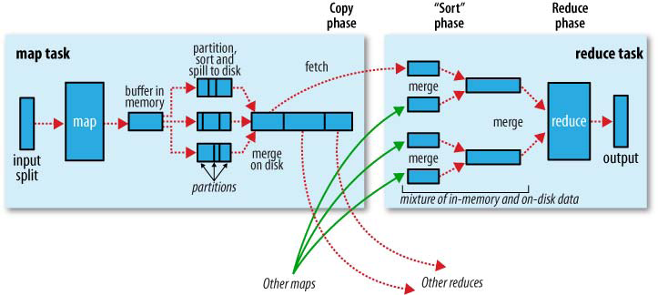
Mapreduce Internals

Slide 107
The Map Side
When the map function starts producing output, it is not simply written to disk.
Each map task has a circular memory buffer that it writes the output to. The buffer is 100 MB by default, a size which can be tuned by changing the io.sort.mb property
When the contents of the buffer reaches a certain threshold size (io.sort.spill.per cent, default 0.80, or 80%) a background thread will start to spill the contents to disk.
Map outputs will continue to be written to the buffer while the spill takes place, but if the buffer fills up during this time, the map will block until the spill is complete.
Before it writes to disk, the thread first divides the data into partitions corresponding to the reducers that they will ultimately be sent to. Within each partition, the background thread performs an in-memory sort by key, and if there is a combiner function, it is run on the output of the sort.

Slide 108
Shuffle and Sort
MapReduce makes the guarantee that the input to every reducer is sorted by key.
The process by which the system performs the sort—and transfers the map outputs to the reducers as inputs—is known as the Shuffle.

Slide 109
How do reducers know which tasktrackers to fetch map output from?
As map tasks complete successfully, they notify their parent tasktracker of the status update, which in turn notifies the jobtracker. These notifications are transmitted over the heartbeat communication mechanism. Therefore, for a given job, the jobtracker knows the mapping between map outputs and tasktrackers.
A thread in the reducer periodically asks the jobtracker for map output locations until it has retrieved them all.
Tasktrackers do not delete map outputs from disk as soon as the first reducer has retrieved them, as the reducer may fail. Instead, they wait until they are told to delete them by the jobtracker, which is after the job has completed.

Slide 110
Task JVM Reuse
Hadoop runs tasks in their own Java Virtual Machine to isolate them from other running tasks.
Jobs that have a large number of very short-lived tasks (these are usually map tasks) or that have lengthy initialization, can see performance gains when the JVM is reused for subsequent tasks.
With task JVM reuse enabled, tasks do not run concurrently in a single JVM. The JVM runs tasks sequentially.
Tasktrackers can however run more than one task at a time, but this is always done in separate JVMs.

Slide 111
Skipping Bad Records
The best way to handle corrupt records is in your mapper or reducer code. You can detect the bad record and ignore it, or you can abort the job.
In rare cases, though, you can’t handle the problem because there is a bug in a thirdparty library that you can’t work around in your mapper or reducer. In these cases, you can use Hadoop’s optional skipping mode for automatically skipping bad records
When skipping mode is enabled, tasks report the records being processed back to the tasktracker. When the task fails, the tasktracker retries the task, skipping the records that caused the failure. by throwing an exception

Slide 112
Task Failure
User code in the map or reduce task throws a runtime exception.
Child JVM reports the error back to its parent tasktracker, before it exits.
The error ultimately makes it into the user logs.
The tasktracker marks the task attempt as failed, freeing up a slot to run another task.
Hanging tasks
The tasktracker notices that it hasn’t received a progress update for a while, and proceeds to mark the task as failed.
The child JVM process will be automatically killed after this period
The timeout period after which tasks are considered failed is normally 10 minutes

Slide 113
Rescheduling task
When the jobtracker is notified of a task attempt that has failed (by the tasktracker’s heartbeat call) it will reschedule execution of the task.
The jobtracker will try to avoid rescheduling the task on a tasktracker where it has previously failed
If a task fails more than four times, it will not be retried further.
The maximum number of attempts to run a task is controlled by the mapred.map.max.attempts property for map tasks, and mapred.reduce.max.attempts for reduce tasks.

Slide 114
Tasktracker Failure
If a tasktracker fails by crashing, or running very slowly, it will stop sending heartbeats to the jobtracker.
The jobtracker will notice a tasktracker that has stopped sending heartbeats and remove it from its pool of tasktrackers to schedule tasks on.
The jobtracker arranges for map tasks that were completed successfully on tasktracker to be rerun if they belong to incomplete jobs, since their intermediate output residing on the failed tasktracker’s local filesystem may not be accessible to the reduce task.
A tasktracker can also be blacklisted by the jobtracker, even if the tasktracker has not failed. A tasktracker is blacklisted if the number of tasks that have failed on it is significantly higher than the average task failure rate on the cluster.
Blacklisted tasktrackers can be restarted to remove them from the jobtracker’s blacklist.

Slide 115
Jobtracker Failure
Failure of the jobtracker is the most serious failure mode.
Currently, Hadoop has no mechanism for dealing with failure of the jobtracker—it is a single point of failure—so in this case the job fails.

Slide 116
Workshop
Instruction:
Walkthrough of Mapreduce scripts and processes
Installing a Cloudera VM
Running a Mapreduce program
Going through Cloudera Tools

Slide 117
Test Your Understanding
Describe a Mapreduce job and its components ?
What are the Advantages of a Mapreduce job ?
Describe Task failure and recovery ?
How can bad records be skipped ?
How do reducers know which tasktrackers to fetch map output from?

Slide 118
Summary
The first phase of a MapReduce program is called mapping. A list of data elements are provided, one at a time, to a function called the Mapper, which transforms each element individually to an output data element.
Reducing lets you aggregate values together. A reducer function receives an iterator of input values from an input list. It then combines these values together, returning a single output value.
At the highest level, there are four independent entities:
Client, Mapper, Reducer and HDFS.
When skipping mode is enabled, tasks report the records being processed back to the tasktracker. When the task fails, the tasktracker retries the task, skipping the records that caused the failure. by throwing an exception

Slide 119
Hadoop
Session VII - MapReduce Types formats and features

Slide 120
Overview
This chapter will introduce you to the different types of input and output formats used in Mapreduce programming.

Slide 121
Objectives
After completing this chapter you will be able to:
Describe various input formats
Describe various output formats
Describe Input Splits
Write a Mapreduce program

Slide 122
Input Splits and Records
Input splits are represented by the Java interface, InputSplit.
An InputSplit has a length in bytes, and a set of storage locations
Split doesn’t contain the input data; it is just a reference to the data.
We don’t need to deal with InputSplits directly, as they are created by an InputFormat.

Slide 123
Input Format
An InputFormat is responsible for creating the input splits, and dividing them into records
FileInputFormat is the base class for all implementations of InputFormat that use files as their data source

Slide 124
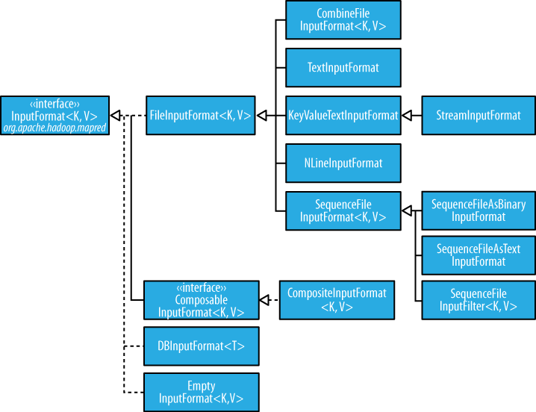
Input format Hierarchy

Slide 125
Small files and CombineFileInputFormat
Hadoop works better with a small number of large files than a large number of small files.
One reason for this is that FileInputFormat generates splits in such a way that each split is all or part of a single file. If the file is very small (“small” means significantly smaller than an HDFS block) and there are a lot of them, then each map task will process very little input, and there will be a lot of them (one per file), each of which imposes extra bookkeeping overhead.
The situation is alleviated somewhat by CombineFileInputFormat, which was designed to work well with small files. Where FileInputFormat creates a split per file, CombineFileInputFormat packs many files into each split so that each mapper has more to process.

Slide 126
TextInputFormat
TextInputFormat is the default InputFormat. Each record is a line of input.
The key, a LongWritable, is the byte offset within the file of the beginning of the line.
The value is the contents of the line, excluding any line terminators.
On the top of the Crumpetty Tree
The Quangle Wangle sat,
But his face you could not see,
On account of his Beaver Hat.
Its divided into one split of four records. The records are interpreted as the following
key-value pairs:
(0, On the top of the Crumpetty Tree)
(33, The Quangle Wangle sat,)
(57, But his face you could not see,)
(89, On account of his Beaver Hat.)

Slide 127
KeyValueTextInputFormat
TextInputFormat’s keys, being simply the offset within the file, are not normally very useful. It is common for each line in a file to be a key-value pair, separated by a delimiter such as a tab character. For example, this is the output produced by TextOutputFormat, Hadoop’s default OutputFormat. To interpret such files correctly, KeyValueTextInputFormat is appropriate.
specify the separator via the key.value.separator.in.input.line property
line1→On the top of the Crumpetty Tree
line2→The Quangle Wangle sat,
line3→But his face you could not see,
line4→On account of his Beaver Hat.
keys are the Text sequences before the tab in each line:
(line1, On the top of the Crumpetty Tree)
(line2, The Quangle Wangle sat,)
(line3, But his face you could not see,)
(line4, On account of his Beaver Hat.)

Slide 128
NLineInputFormat
If you want your mappers to receive a fixed number of lines of input, then NLineInputFormat is the InputFormat to use.
Like TextInputFormat, the keys are the byte offsets within the file and the values are the lines themselves.
On the top of the Crumpetty Tree
The Quangle Wangle sat,
But his face you could not see,
On account of his Beaver Hat.
If, for example, N is two, then each split contains two lines. One mapper will receive the first two key-value pairs:
(0, On the top of the Crumpetty Tree)
(33, The Quangle Wangle sat,)
And another mapper will receive the second two key-value pairs:
(57, But his face you could not see,)
(89, On account of his Beaver Hat.)

Slide 129
SequenceFileInputFormat
Hadoop’s sequence file format stores sequences of binary key-value pairs.
They support compression as a part of the format.

Slide 130
DBInputFormat
DBInputFormat is an input format for reading data from a relational database, using JDBC.

Slide 131
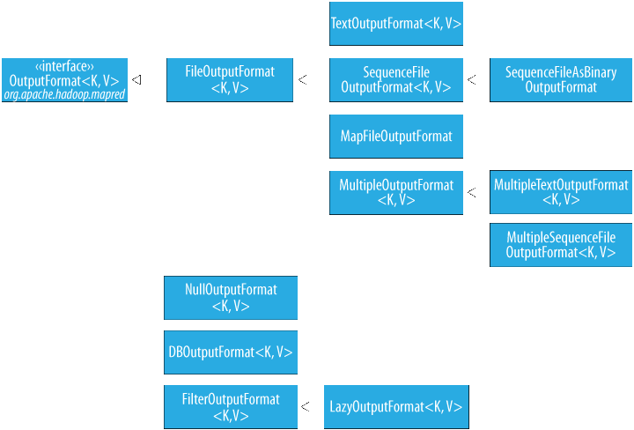
Output Formats

Slide 132
Sample Mapper
public class MaxTemperatureMapper extends MapReduceBase
implements Mapper<LongWritable, Text, Text, IntWritable> {
public void map(LongWritable key, Text value,
OutputCollector<Text, IntWritable> output, Reporter reporter)
throws IOException {
String line = value.toString();
String year = line.substring(15, 19);
int airTemperature;
if (line.charAt(87) == '+') { // parseInt doesn't like leading plus signs
airTemperature = Integer.parseInt(line.substring(88, 92));
} else {
airTemperature = Integer.parseInt(line.substring(87, 92));
}
String quality = line.substring(92, 93);
if (airTemperature != MISSING && quality.matches("[01459]")) {
output.collect(new Text(year), new IntWritable(airTemperature));
}
}

Slide 133
Sample Reducer
public class MaxTemperatureReducer extends MapReduceBase
implements Reducer<Text, IntWritable, Text, IntWritable> {
public void reduce(Text key, Iterator<IntWritable> values,
OutputCollector<Text, IntWritable> output,
Reporter reporter) throws IOException {
int maxValue = Integer.MIN_VALUE;
while (values.hasNext()) {
maxValue = Math.max(maxValue, values.next().get());
}
output.collect(key, new IntWritable(maxValue))
}
}

Slide 134
Sample Driver
public static void main(String[] args) throws IOException {
JobConf conf = new JobConf(MaxTemperature.class);
conf.setJobName("Max temperature");
FileInputFormat.addInputPath(conf, new Path(args[0]));
FileOutputFormat.setOutputPath(conf, new Path(args[1]));
conf.setMapperClass(MaxTemperatureMapper.class);
conf.setReducerClass(MaxTemperatureReducer.class);
conf.setOutputKeyClass(Text.class);
conf.setOutputValueClass(IntWritable.class);
JobClient.runJob(conf);
}

Slide 135

MapReduce – Other languages
Mapper / Reducer can be written in your favorite languages as well using hadoop streaming support
Supported Languages
C++
Python
Jython
PERL
Shell Scripting
PHP etc.
Example
$ bin/hadoop jar contrib/hadoop-*-streaming.jar \
-mapper $HOME/proj/hadoop/multifetch.py \
-reducer $HOME/proj/hadoop/reducer.py \
-input urls/* -output titles

Slide 136
Source
Hadoop – The definitive Guide
http://hadoop.apache.org/
http://hadoop.apache.org/common/docs/r0.20.2/mapred_tutorial.html
http://hadoop.apache.org/hdfs/
Disclaimer: Parts of the content of this course is based on the materials available from the Web sites and books listed above. The materials that can be accessed from linked sites are not maintained by Cognizant Academy and we are not responsible for the contents thereof. All trademarks, service marks, and trade names in this course are the marks of the respective owner(s).

Slide 137
Test Your Understanding
What are the types of Input formats ?
What are the types of output formats ?
Where is combine Input format used and why?

Slide 138
Summary
Hadoop supports a number of input and output formats based on the file formats to be read/written.
CombineLineInput format is used to alleviate the problem of small files in hadoop.
TextInput format is the default format.
NlineInputFormat takes number of lines a s a logical record.
Sequence file format stores sequences of binary key-value pairs.

Slide 139
Hadoop
Session VIII - Mapreduce Hands On

Slide 140
Map ReduceHands On
Workshop would include:
Map Reduce Example Program and Execution
Hadoop Streaming and Execution

Slide 141
Questions

Slide 142
Hadoop
You have successfully completed -
Hadoop

